Slide 1
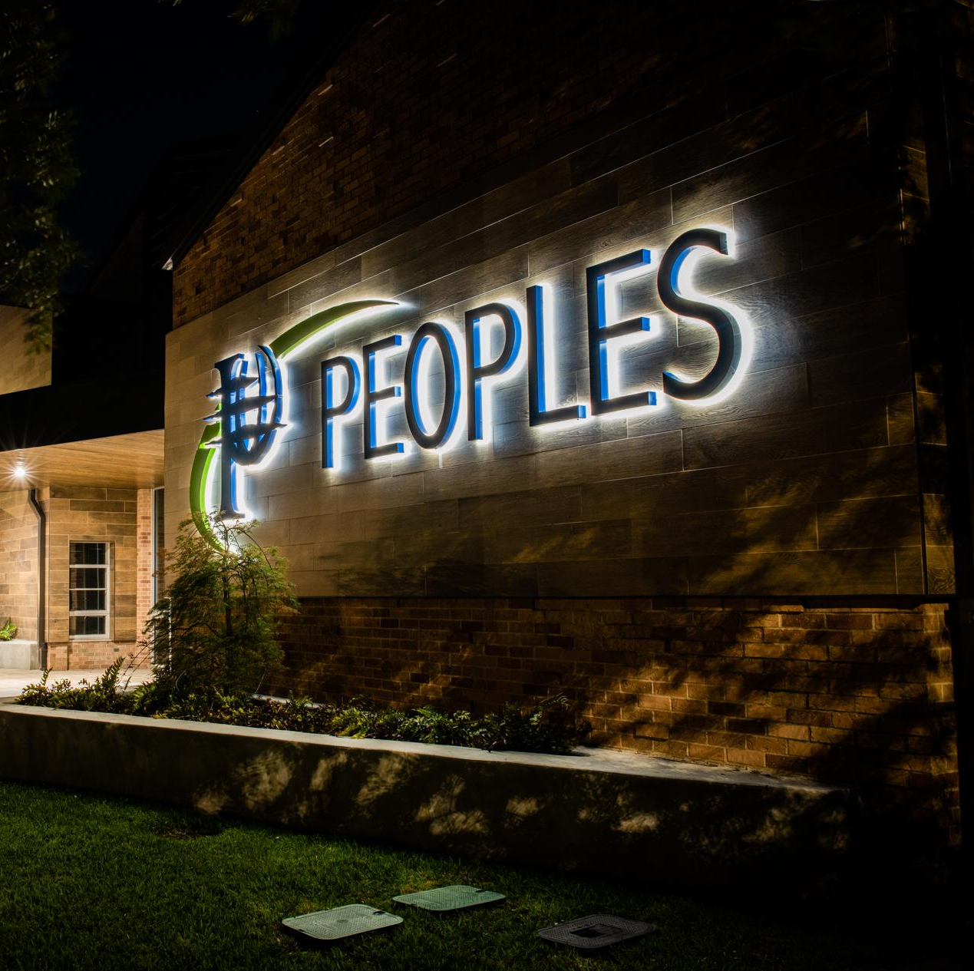
City of Mineola
Broadband Expansion
Jason Slagle
Chief Business Development Officer

Slide 2
Peoples is seeking an initiative to enhance and extend fiber broadband connectivity throughout the City of Mineola, aiming to achieve impressive target speeds of up to 5 Gigabits per second for residential and up to 100 Gigabit for commercial customers.
The deployment of this advanced infrastructure will revolutionize internet accessibility and reliability for both residential and commercial entities, presenting an innovative and competitive opportunity for the community.
This initiative would serve as an additional catalyst for economic growth, empowering local businesses to thrive in a digitally interconnected world. Residents, too, will benefit from a seamless online experience, enabling them to engage in remote work, online education, and various entertainment options without any compromise in speed or reliability.

Slide 3
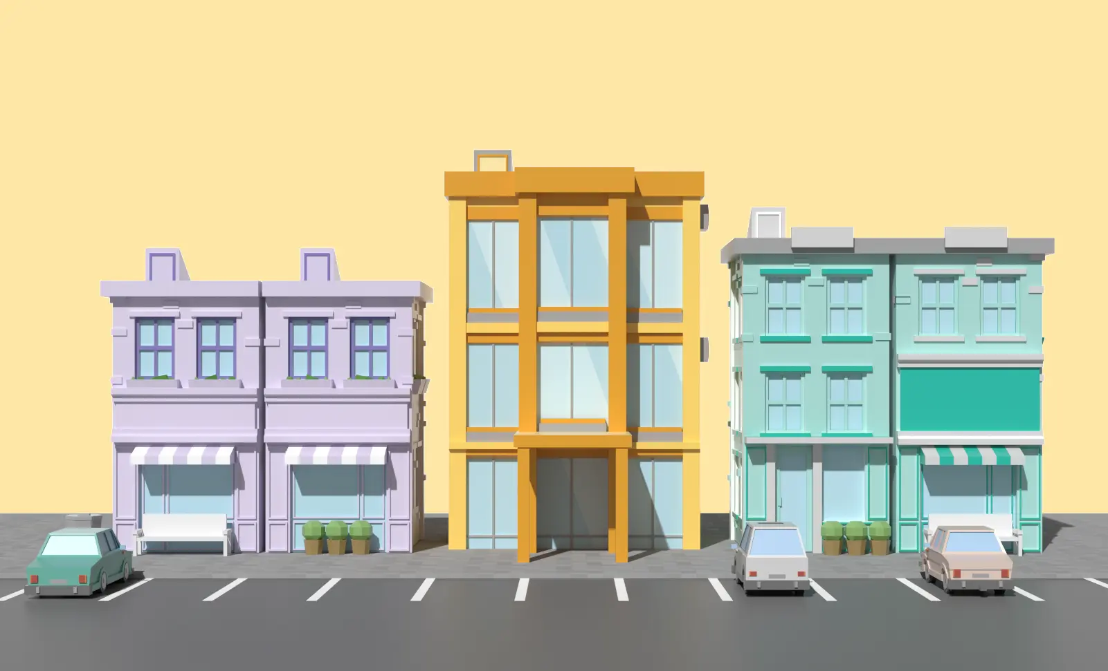
Why (Multi)Gigabit-City
Attracts businesses - high speed and reliable connections
Allows remote work , online learning, and other service like Tele-health
Fiber is a Reliable Service 99.995%
Internet Cost decrease - More Competition
Higher Bandwidth - 400G backhaul
Increased home values
Increases property Tax paid to City and Schools by Providers Peoples - 1.5K/12K

Slide 4
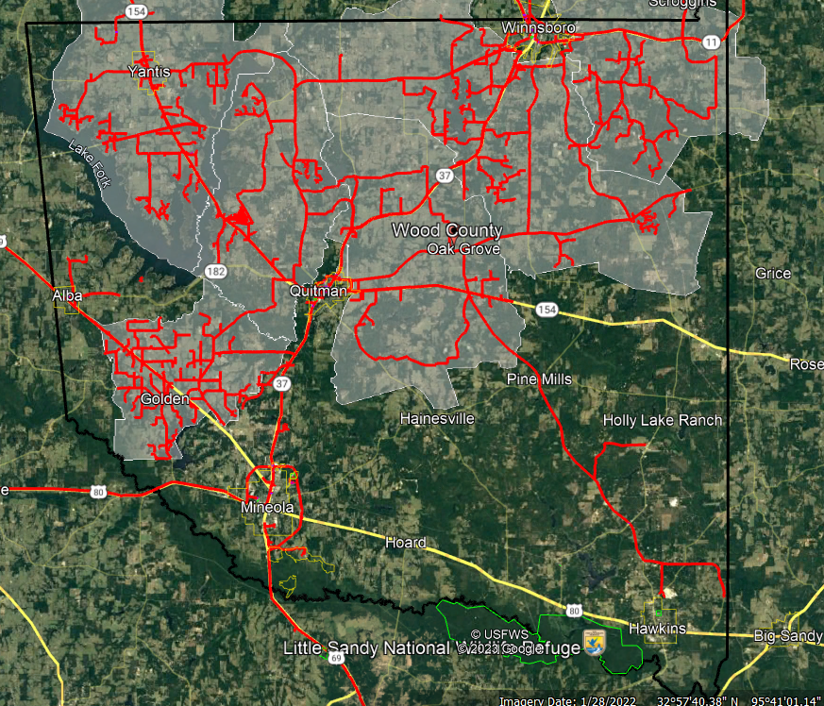
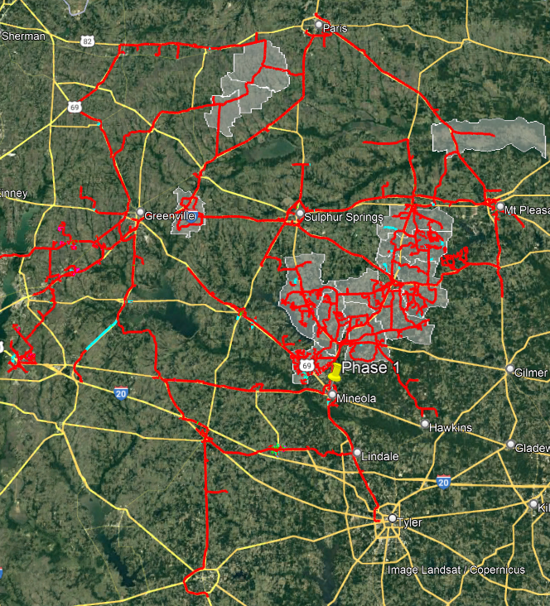
Peoples
ILEC
Boundary
Wood County

Slide 5
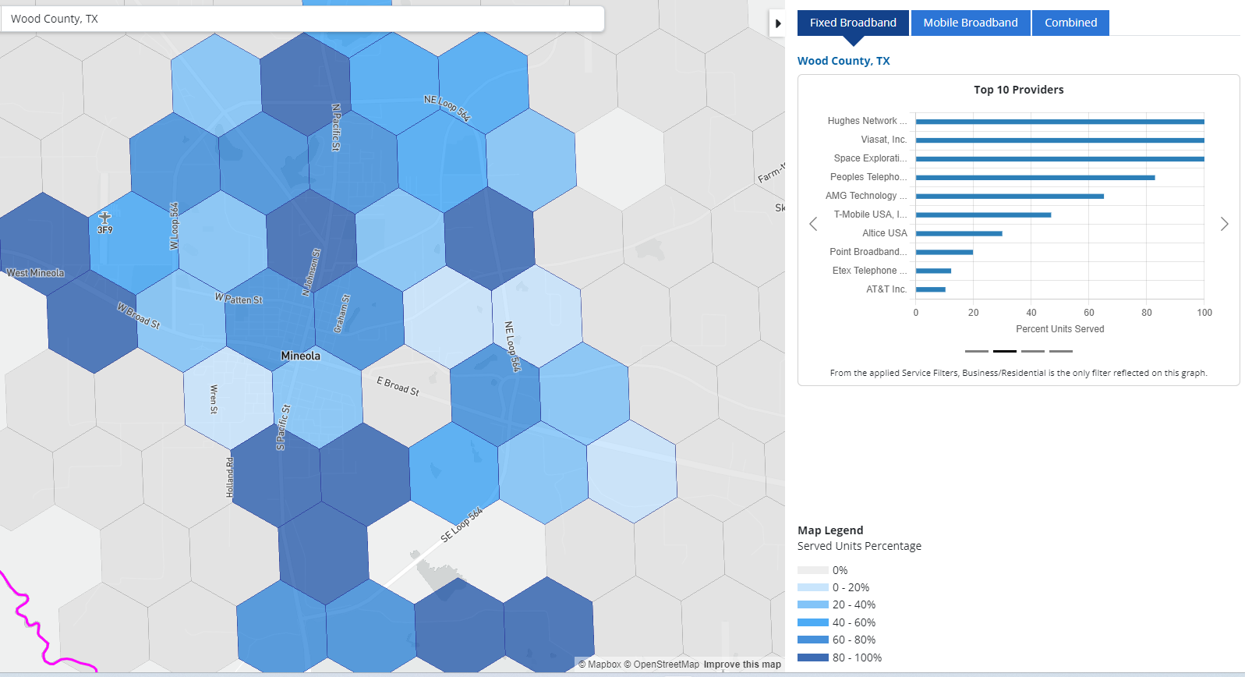
FCC Broadband Data

Slide 6
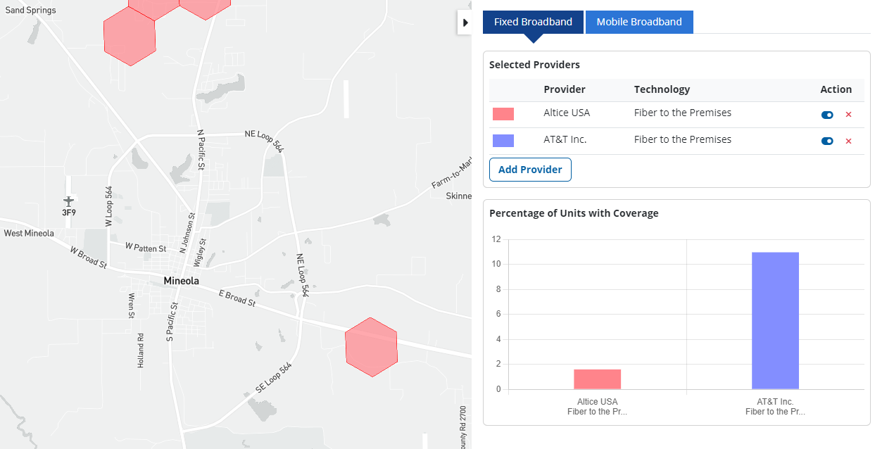
Who provides Fiber in Mineola

Slide 7
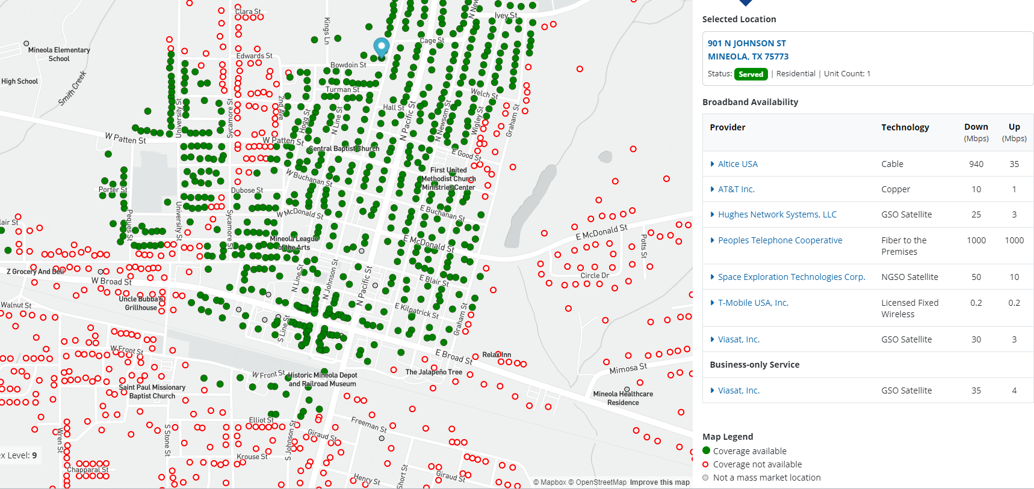
Provider Data

Slide 8
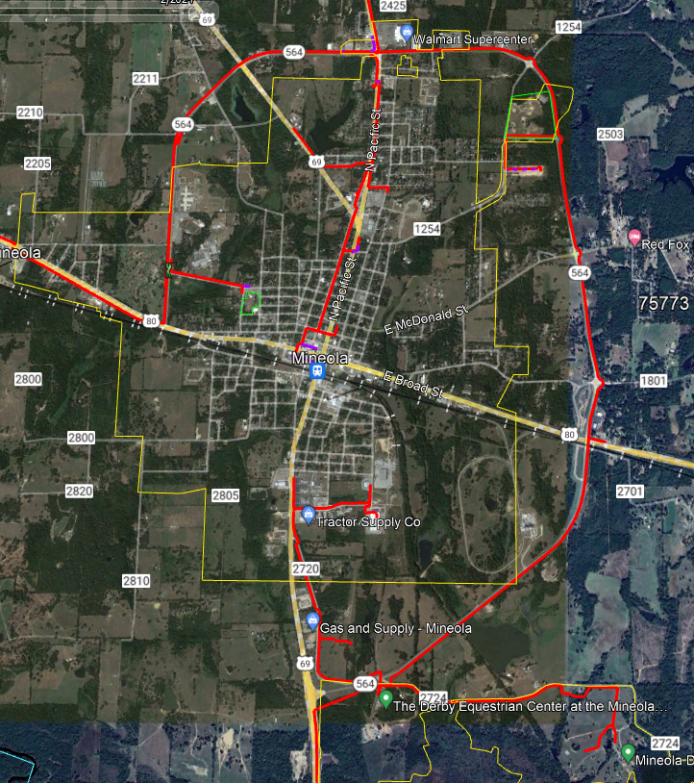
Peoples Fiber (Current)
Wood County

Slide 9
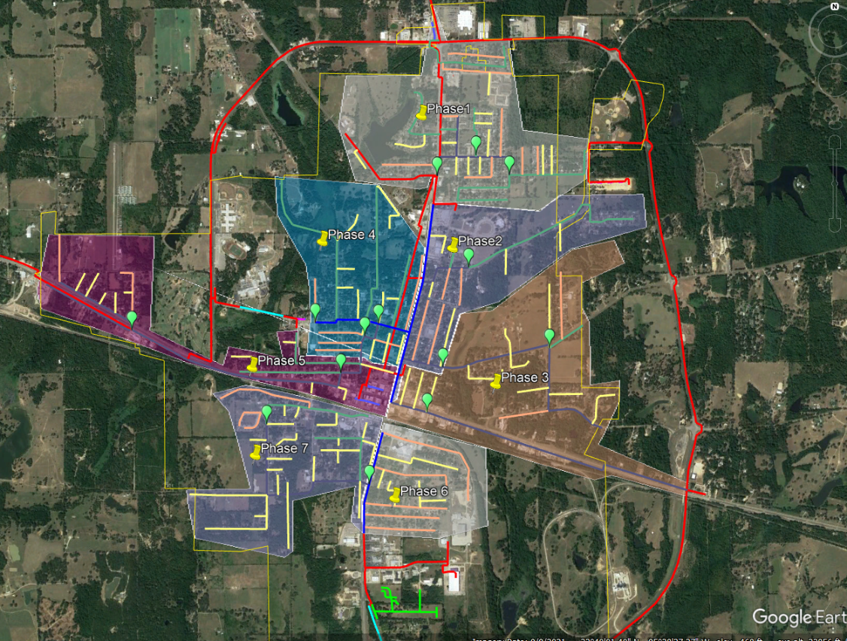
Peoples
Mineola
7 Phase Approach
Wood County

Slide 10
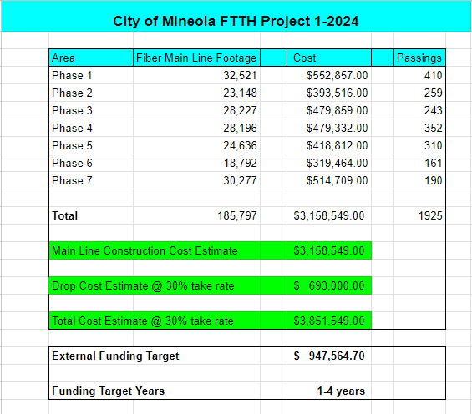
Financials

